Slide 1
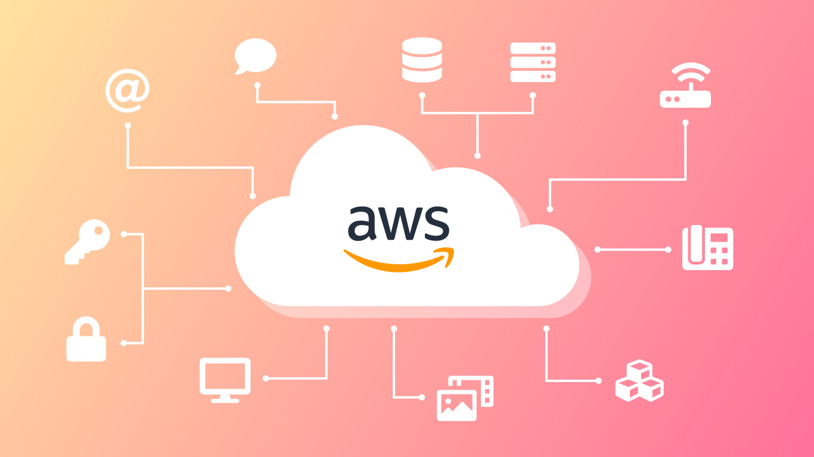
Introduction to AWS Security

Slide 2
Why Security is Critical in the Cloud
The shift to cloud computing has brought new security challenges and opportunities.
AWS provides a shared responsibility model where security is a shared concern between AWS and the customer.
AWS offers a broad set of services and features to ensure the security of your cloud environment.
AWS's Commitment to Security
AWS's infrastructure is designed for the highest levels of security, including data encryption, physical security, and compliance with global regulations.
AWS continually updates its security features to adapt to evolving threats.

Slide 3
AWS Shared Responsibility Model
Understanding the Shared Responsibility Model
AWS's Responsibility: Securing the cloud infrastructure, including physical hardware, network infrastructure, and hypervisors.
Customer's Responsibility: Securing data in the cloud, including managing IAM policies, data encryption, and configuring network security.
Example: AWS secures the hardware running EC2 instances, while the customer is responsible for securing the OS, application software, and data on the instance.
Implications for Security Management
The model emphasizes the need for customers to implement strong security practices and configurations to ensure their cloud resources are secure.

Slide 4
AWS Identity and Access Management (IAM)
IAM allows you to manage access to AWS services and resources securely.
You can create and manage AWS users and groups and use permissions to allow and deny their access to AWS resources.
Key Features of IAM
Users, Groups, and Roles: Create users, organize them into groups, and assign permissions using roles.
IAM Policies: JSON documents that define what actions are allowed or denied for users, groups, and roles.
Multi-Factor Authentication (MFA): Adds an extra layer of protection by requiring a second form of authentication.
Best Practices:
Enforce the principle of least privilege: Grant users only the permissions they need.
Use roles for applications that run on EC2 instances, instead of storing credentials within the instance.

Slide 5
AWS Key Management Service (KMS)
KMS is a managed service that makes it easy to create and control the encryption keys used to encrypt your data.
KMS integrates with other AWS services to simplify the encryption of data at rest and in transit.
Features and Capabilities
Customer Managed Keys (CMKs): Create and manage your own encryption keys.
Automatic Key Rotation: KMS can automatically rotate keys at regular intervals.
Integration with AWS Services: Seamlessly integrate KMS with services like S3, EBS, RDS, and more.
Use Cases
Encrypting data stored in S3 buckets.
Encrypting database instances in RDS.
Encrypting data on EBS volumes attached to EC2 instances.

Slide 6
AWS CloudTrail and CloudWatch
AWS CloudTrail
CloudTrail provides governance, compliance, and operational and risk auditing of your AWS account.
It records API calls and other actions across your AWS account and delivers the log files to an S3 bucket.
Key Features
Event History: View detailed history of API calls made in your AWS account.
Insights: Automatically detects unusual account activity.
Compliance and Auditing: Helps you meet compliance requirements by tracking all API activity.

Slide 7
AWS CloudWatch
CloudWatch provides monitoring for AWS resources and applications you run on AWS.
It collects and tracks metrics, monitors log files, and sets alarms.
Security Monitoring with CloudWatch
Use CloudWatch to monitor the health and performance of your security configurations.
Set up alarms to notify you of unusual activity or potential security issues.
Integrate with CloudTrail to gain comprehensive visibility into your environment.

Slide 8
AWS Security Hub
Introduction to AWS Security Hub
Security Hub provides a comprehensive view of your security posture across your AWS accounts.
It aggregates, organizes, and prioritizes security findings from multiple AWS services, such as GuardDuty, Inspector, and Macie.
Key Features
Centralized View: Security Hub consolidates findings from various security services into a single dashboard.
Automated Compliance Checks: Continuously monitors your environment against best practices and industry standards.
Integration with AWS Services: Automatically integrates with GuardDuty, Inspector, Macie, and more to provide comprehensive security insights.
Benefits
Simplifies security management by providing a single pane of glass for monitoring and responding to security issues.
Enhances your ability to detect and respond to security threats.

Slide 9
AWS GuardDuty, Inspector, and Macie
AWS GuardDuty
A threat detection service that continuously monitors your AWS accounts for malicious activity and unauthorized behavior.
Uses machine learning, anomaly detection, and integrated threat intelligence to identify and prioritize potential threats.
AWS Inspector
An automated security assessment service that helps improve the security and compliance of applications deployed on AWS.
It checks for common vulnerabilities and deviations from best practices in your EC2 instances.
AWS Macie
A data security service that uses machine learning to automatically discover, classify, and protect sensitive data in AWS.
Identifies sensitive data, such as personally identifiable information (PII), and monitors access to it.

Slide 10
Data Protection and Encryption
Encrypting Data at Rest and in Transit
AWS provides multiple options for encrypting data stored in and moving between AWS services.
S3 Encryption: Use server-side encryption (SSE) or client-side encryption to secure data stored in S3.
EBS Encryption: Encrypt EBS volumes attached to your EC2 instances.
RDS Encryption: Enable encryption for RDS database instances to protect stored data.
Transport Layer Security (TLS)
Ensure data is encrypted in transit using TLS across AWS services like API Gateway, CloudFront, and ELB.
AWS Certificate Manager (ACM) helps manage SSL/TLS certificates for your applications.
Encryption Best Practices
Use AWS KMS to manage your encryption keys and automate key rotation.
Encrypt sensitive data both at rest and in transit.
Regularly review and audit encryption configurations.

Slide 11
Compliance and Governance
AWS Compliance Programs
AWS complies with numerous global security standards, including ISO 27001, SOC 1/2/3, PCI DSS, GDPR, HIPAA, and more.
AWS Artifact provides on-demand access to compliance reports and agreements.
Implementing Governance
Use AWS Organizations and Service Control Policies (SCPs) to enforce governance and compliance across your accounts.
AWS Config helps monitor compliance by tracking resource configurations and comparing them against desired configurations.
AWS Well-Architected Framework
The Security Pillar of the AWS Well-Architected Framework provides guidelines for implementing security in the cloud.
Focuses on key areas such as identity management, infrastructure protection, data protection, and incident response.

Slide 12
Recap of AWS Security Management
AWS offers a comprehensive set of security tools and services that enable organizations to secure their cloud environments effectively.
Understanding and leveraging the shared responsibility model is key to ensuring robust security.
Regularly update and review your security configurations to stay ahead of emerging threats.

